Slide 1

BULLETIN.CZ and HSO cooperation

Slide 2
Market analysis

Slide 3
Market dynamics – Czech Republic
Demographic/ Environment
Regulatory/ Reimbursement
Population 10,8 mio, life expectancy 81/75 years (women/men)
Population >65 years 2,21 mio (20,5 %)
Private healthcare – pure private sector is very small; private doctors and clinics work through agreements with health insurance companies adding some co-payment
Public healthcare – high quality, majority of new technologies are available in state hospitals, general problem with doctor ageing and care availability in the regions
Cataract operation is fully reimbursed by state health insurance
This covers basic IOLs (monofocal), differentiation between hydrophobic a hydrophilic, reimbursement through “package codes”
Clinics ask for co-payment for services (e.g. package: individual examination, retina check, senior surgeon, multifocal IOL)
Key Product launches/ Competition
Economy
Zeiss: no major new IOL launches in 2024–25
Alcon: Clareon® PanOptix® Pro Trifocal IOL, Vivity® EDOF
JJVS:TECNIS Odyssey Trifocal IOL
Rayner: Galaxy® EDOF
Medicontur: ELON EDOF
Economic growth 2024 vs 2023: +1,0% (weak growth)
Overlook for 2025: +1,3%
Unemployment: 3,8%
Government debt: 42,8 % of GDP
Avg income: 40 854,- CZK (1 812 EUR)
CZK/EUR 2025 vs 2024 revaluation of 4%
Notes:
Provide short summary for each of the categories for your market for expected changes until 2030; if possible indicate expected implementation year
- Demographic/ Environment
- Regulatory/ Reimbursement
- Economy
- Key Preoduct launches/ Competition

Slide 4
Market dynamics – Slovak Republic
Demographic/ Environment
Regulatory/ Reimbursement
Population 5,4 mio, life expectancy 78,65 years
Population >65 years 0,918 mio (17 %)
Private healthcare – pure private sector is very small; private doctors and clinics work through agreements with health insurance companies adding some co-payment
Public healthcare – medium/low quality depending on hospital type, majority of new technologies are available in private and selected state hospitals, general problem with doctor financing and investments to infrastructure/equipment
Cataract operation is fully reimbursed by state health insurance
The particular IOLs are listed in reimbursement list including the reimbursed amount, i.e. it’s crucial to list the IOL and get the reimbursement (timely process)
In 2024 the government cut the payments for private clinics and redirected the money to state hospitals
Clinics ask for co-payment for services (e.g. package: individual examination, retina check, senior surgeon, multifocal IOL)
Economy
Key Product launches/ Competition
Zeiss: no major new IOL launches in 2024–25
Alcon: Clareon® PanOptix® Pro Trifocal IOL, Vivity® EDOF
JJVS:TECNIS Odyssey Trifocal IOL
Rayner: Galaxy® EDOF
Medicontur: ELON EDOF
Economic growth 2024 vs 2023: +2,1% (growth)
Overlook for 2025: +1,3%
Unemployment: 5,3%
Inflation: 2,8% (2024) and 4,4% (Jul 25)
Government debt: 59,3 % of GDP
Avg income: 1.518,- EUR
Notes:
Provide short summary for each of the categories for your market for expected changes until 2030; if possible indicate expected implementation year
- Demographic/ Environment
- Regulatory/ Reimbursement
- Economy
- Key Preoduct launches/ Competition

Slide 5
Market segmentation - public/private approach
Account name/Segment | Public/training hospitals | University hospitals | Private hospitals managed by investors | Private clinic Independent Price focus | Private clinic Independent Quality focus | Private “boutique” clinics | Private clinic Chains with multiple locations
Clinical decision | Yes | yes | yes | yes | yes | yes | yes
Adoption of new technologies | selectively depends on: activity of Head of department investment potential | High – trend setting and KOL prestige depends on: activity of Head of department investment potential | selectively depends on: activity of Head of department investment potential | low depends on: - investment potential | high depends on: - investment potential | high depends on: - investment potential | selectively depends on: activity of Head of department investment potential
Payment for surgery | Reimbursement covers basics, in some hospitals co payment possible | Reimbursement covers basics, in some hospitals co payment possible | Reimbursement covers basics, limited co-payment possible | Reimbursement covers basics, in some hospitals co payment possible | Reimbursement covers basics, in some hospitals co payment possible | Reimbursement covers basics, in some hospitals co payment possible | Reimbursement covers basics, in some hospitals co payment possible
Efficiency | depends on - organization which results in contract with health Insurance (nr of cataracts) | depends on - organization which results in contract with health Insurance (nr of cataracts) | depends on service level and uniqueness personal approach sales effectiveness | depends on - organization which results in contract with health Insurance (nr of cataracts | Depends on - service level and sales effectiveness | depends on - service level and sales effectiveness | depends on - organization which results in contract with health Insurance (nr of cataracts)
Price focus | Price is desirable, quality saved for complicated patients | Price is desirable, quality saved for complicated patients | Price is desirable, quality saved for complicated patients | Price is desirable, quality saved for complicated patients | Price is important, quality used as attraction for clients | Price is noted, quality used for differentiation and client attraction | Price is desirable, quality saved for complicated or co-payed patients
Service required | Perform basic service for the area | High level service, doctor education | Perform basic service for the area | Perform basic service for clients | Perform high level service for clients | Perform high level service for clients | Perform basic service for the clients in the country
Sales focus | New tech adoption – increase efficiency and success | Training, presentations, KOL | New tech adoption – increase efficiency and success | New tech adoption – increase efficiency and profit | New tech adoption – increase quality, reputation and success | New tech adoption – increase quality, reputation and success | New tech adoption – increase efficiency and success
Potential | 15 000 | 30 000 | 10 000 | 20 000 | 20 000 | 10 000 | 50 000
priority | ** 3 | *** 1 | * 4 | *** 4 | ***** 1 | ***** 1 | *** 2

Slide 6
Key decision criteria - 7 Global Key Segments
 | public/private approach
Account name/ Segment | Public/training hospitals | University hospitals | Private hospitals managed by investors | Private clinic Independent Price focus | Private clinic Independent Quality focus | Private clinic “boutique” clinics | Private clinic Chains with multiple locations
Key decision criteria/ critical success factors | 1.Cost and reimbursement 2.Surgeon preference 3.Training | 1.Cost and reimbursement 2.Surgeon preference 3.Technology, innovation 4.Clinical outcomes 5.Education | 1.Cost and reimbursement 2.Purchasing chain input 3.Surgeon preference | 1.Cost and reimbursement 2.Surgeon preference 3.Technology, innovation 4.Clinical outcomes 5.Education | 1.New products, show premium attitude 2.Cost and reimbursement 3.Surgeon preference 4Technology 5.Clinical outcomes 6.Education | 1.Cost and reimbursement 2.Clinical outcomes 3.Technology – more effective operations 4.Surgeon preference 5.Education | 1.Cost and reimbursement 2.Surgeon preference 3.Technology 4.Clinical outcomes 5.Education
Major focus on the segments where price is not the only decision point and surgeon preference and interest in innovative products will play the role – Private – quality, boutique, chain; Public – University. There is lack of experienced cataract surgeons in the market and both state and private hospital fight for them. The surgeons have agreements and work in both – state and private clinics. This gives opportunities: 1.If we enter private clinic, the surgeon will get familiar with the lenses and we can use him to enter big state hospital 2.Clinics want to fulfill surgeons’ preferences to keep them and their opinion in what to implant is very important (and can partially overcome price issue)
Notes:
Global standard key account segmentation – please add/ describe additional/ other local key accounts

Slide 7
Value Chain Flow Chart
“Package code” (Health insurance) - FOC for patient COMMODITY IOL » GOOD IOL
Clinical packages– ”Package code” + patient co-pay–depend on the scheme limit – GOOD IOL » PCIOL
Private clinic
Clinical packages– ”Package code” + patient co-pay–depend on the scheme limit – The BEST IOL » PCIOL
Out of pocket - BEST IOL » PCIOL (increasing with medical tourism)
Patient
“Package code” (Health insurance) - FOC for patient COMMODITY IOL » GOOD IOL
Public hospital
Clinical packages– ”Package code” + patient co-pay–depend on the scheme limit. – The BEST IOL » PCIOL
Out of pocket – negligible volume - ANY IOL » PCIOL w/o insurance

Slide 8
Reimbursement "packages" available in the Czech Rep.
Package 1: Cataract surgery using a hydrophilic or hard lens, priced at CZK 11,654 = 466 EUR
Package 2: Cataract surgery using a hydrophobic lens, priced at CZK 16,000 = 640 EUR
Package 3: Cataract surgery using a toric lens, priced at CZK 16,527 = 661 EUR
Included are the following reimbursed services, which are covered under the above procedures:
a) Comprehensive ophthalmological examination – includes patient admission and discharge to home care, b) Targeted ophthalmological examination, c) Refraction examination using autorefractor (1 eye),d) Ocular biometry by echo (1 eye), e) Anterior segment and fundus photography (1 eye), f) Phacoemulsification (1 eye),g) Intraocular lens implantation procedure: 75347 – Intraocular lens implantation – PMMA (1 eye) or 75348 – Intraocular lens implantation – soft (foldable) (1 eye),h) Use of microscope during surgery per 10 minutes.

Slide 9
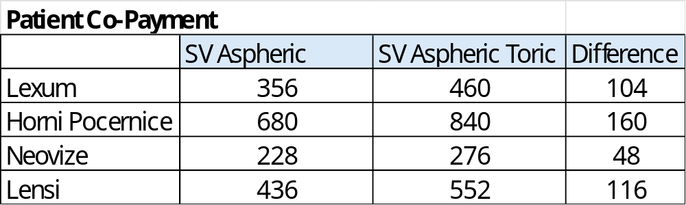
Co-payments for monofocal toric versus monofocal
Both private and state clinics use toric feature as additional option for asking higher co-payment from the patients.

Slide 10




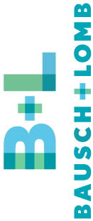

Competitor's SWOT
Strengths
Product focus to premium IOLs with high quality delivered
Extensive clinical support for surgeons
Established organization covering the market
Enhanced mono availability
Relations with KOLs
Weaknesses
Opportunities
Threats
Utilize relations and team expertise from former projects to enter clinics
Growing toric and mono enhanced preference
Bundling deals w/instrumentation and/or spectacle lenses
Synergy with HOYA Miyosmart project in targeting surgeons
Product stockouts
Hard to overcome established connections between key surgeons and suppliers
Direct organization with long term market expertise and relationships, full line supplier
Full territory coverage
Brand image, portfolio, KOL advocacy
Profes.educ. investments
Patient awareness
Vertical integration
Sales force, portfolio, relations with KOLs, Eyhance/Toric, Launch of Edof Puresee, LCS penetration, share of voice, Profes.educ. investments
Price flexibility
Lack of enhanced mono, (Clareon) glistening @ Acrysof material,
Non complete preloaded portfolio
Too many products to focus
Synergy not well adopted - limited equipment offers
Lack of strategic marketing and COMEX
Growing EDOF preference
Active Phaco and VR and refractive market product bundling
Same as ALCON
More competition rise, new generations of competitive products appear
Economy slowdown could influence ability to pay for top products
Economic slowdown – ability to pay for better materials
HSO/Distributor
ALC
J&J
Lack of EDOF lenses
Newcomer to surgical business in CZ
Market knowledge under development
Distribution channels under development

Slide 11
Competitor's SWOT (continued)
Strength
Wide portfolio, direct organization, access to KOLs, clinical expertise, brand image
Weakness
Opportunity
Threat
Service level
Focused on the equipment business
Missing dedicated sales team specialized in lenses
They are becoming strong in the CZ&SK markets, great future, gaining market share
Be considered as an equipment company not a lens company
Offers a complete surgical platform
Benefit from early market presence, leading to a network of long-term contacts and client loyalty.
Their full portfolio enables bundling strategies, offering clinics both lenses and surgical equipment in integrated deals.
Broad cataract portfolio, EU-ready. RayOne family (monofocal, toric, trifocal, EMV) with a fully preloaded injector; CE/MDR documentation in place for RayOne lines.
Lower Share Of Voice versus ALCON
One man show with company founder, problematic share of experience with others
Share and brand inertia vs. incumbents. CZ clinics frequently publicize competing premium lenses (e.g., Alcon Clareon, ZEISS trifocals), implying strong incumbent pull-through in premium segments
Their full portfolio enables bundling strategies, offering clinics both lenses and surgical equipment in integrated deals.
Expand penetration into the EDOF segment with LuxSmart.
Leverage legacy trust and long-standing relationships for continued market retention.
Offer a non-corporate, flexible approach to partnerships and customer support.
Local KOL/clinic partnerships. Active private chains (Lexum, Gemini, NeoVize) promote premium lens options—targets for RayPRO studies, training, and conversions
Intense premium competition. Strong visibility of Alcon, ZEISS, J&J & others in CZ clinics can compress Rayner’s pricing/mix.
CZM
B&L
Spirit medical
Rayner
Limited Regional Data/Country-Level Insights
Competitive Pressures in Eyecare
Spin-Off and Corporate Uncertainty

Slide 12
Competitor's SWOT (continued)
Strengths
Local footprint & fast support.
Wide portfolio, direct organization, access to KOLs, clinical expertise, brand image
Weaknesses
Opportunities
Threats
Service level
Focused on the equipment business
Missing dedicated sales team specialized in lenses
They are becoming strong in the CZ&SK markets, great future, gaining market share
Be considered as an equipment company not a lens company
Precision positioning. Lenstec’s hallmark ¼-diopter step manufacturing is a clear differentiator
Regional support nearby. European office/distribution hub in Bratislava (CMI)—practical for CZ service, trials, and logistics.
Comprehensive IOL portfolio — Teleon’s line-up includes hydrophilic and hydrophobic IOLs, EDOF, multifocal, varifocal, toric, and more, covering virtually every clinical need
Brand power vs. mega-players. Private CZ marketing often leads with Alcon/Zeiss on premium procedures, so surgeon/patient mindshare tilts to incumbents.
Hydrophilic material bias — Some Teleon lenses (e.g., LENTIS Comfort) use hydrophilic acrylic, which can face skepticism compared to hydrophobic alternatives in certain practices
Local KOL ties. Czech surgeons are visible in presbyopic/“accommodating” IOL discourse; targeted collaborations/trials can raise profile
Full-range positioning — Teleon's diversity (monofocal to premium/toric) is ideal for clinics wanting a one-stop portfolio, easing stocking and workflow.
Strong competition in premium segment — Alcon (PanOptix), J&J (Tecnis), Zeiss (AT LARA), etc., command high clinic and patient trust, making it hard to displace.
Medicontur
Lenstec
Askin Teleon
Intense premium competition. Clinics prominently market Alcon/Zeiss premium lenses; inertia makes displacing default choices costly

Slide 13
Extensive Clinical Support
Dry lab training of selected surgeons to properly use injector&lens
Wet lab training site to simulate the injector&lens use as part of surgeon’s training process (planned for mid 2026)
White paper discussion and guidance with explanation of clinical advantages and outcomes (both 1:1 and group discussions in seminars and congresses)
KOL group creation who will serve as local reference and present on congresses
Regular KOL meetings (peer to peer) with updates and feedbacks
OR presence to assess surgeons’ habits, preferences and guide him/her through first implantations
OR nurses training
Regular OR follow-up to accelerate usage and positive feedback

Slide 14
Org Charts/ FTE HSO and main competitors
 | ALCON -Direct | J&J - Hybrid | CZM - Direct | B&L -Spirit | RAYNER - Dist. | Medicontur
Territory Manager | 0 | 0 | 0 | 0 | 0 | 0
Regional Sales Manager | 4 | 2 | 2 | 2 | 2 | 2
National Sales Manager | 1 | 1 | 1 | 0 | 1 | 0
Clinical Application Specialist - IOL | 2 | 1 | 1 | 1 | 1 | 1
Marketing Manager | 1 | 1 | 1 | 0 | 0 | 0
Marketing Specialist | 1 | 1 | 1 | 0 | 0 | 0
Professional Education Manager | 0 | 0 | 0 | 0 | 0 | 0
Equipment Sales/Clinical | 0 | 0 | 2 | 1 | 1 | 0
 | 9 | 6 | 8 | 4 | 5 | 3
Focus on IOL FTE
Notes:
Please describe org charts of HSO/ distributor and key competitors.
Focus on IOL selling roles
Compare FTE of IOL selling roles of key competitors

Slide 15
Market Pricing Landscape (NET)
Good Mono
Alcon Acrysof / SA60AT (Hydrophobic, monofocal)
FN Olomouc: €49,47
Rayner (Mono Asph)
Lexum: €41,22
J&J Sensar (Mono Asph)
Lexum: €20,61
Lensi: €41,22
B&L Akreos / MI60 (Hydrophilic, monofocal)
ÚVN: €54,00 – not preloaded
Better Mono
Alcon AcrySof IQ with UltraSert (Mono Asph )
Tana: €115,42
Alcon Acrysof / SN60AT (Hydrophobic, monofocal, yellow filter, no injector – reusable Monarch separately)
FN Olomouc: €86,57
J&J Tecnis with Simplicity (Mono Asph )
B&L Akreos / MI60P (Hydrophilic, monofocal) – pre-loaded
FTN: €89,45
Rayner RayOne Hydrophobic Aspheric (Hybrid hydrophobic, monofocal)
Příbram: €103,05
VFN: €76,05
Teleon Lentis / LS313Y (inc. injector) (Hybrid hydrophobic, monofocal)
Karviná: €137,68
**HOYAVivinex iSert** €90,00
Best Mono
Alcon Clareon / (CNA0T0) - manually loaded (Hydrophobic, monofocal)
ÚVN: €121,60 – with AutonoMe inj.
Lexum: €74,20
Alcon Clareon / (SY60WF) autonoMe injector (Hydrophobic, monofocal)
FN Olomouc: €131,91 – lens only, Monarch inj
J&J Tecnic Optiblue (Hydrophobic, monofocal, yellow filter)
VFN: €135,29
**HOYAVivinex mSert * €130,00
Best Mono +
J&J Eyehance
UVN: €135,33
Teleon Acunex Quantum (incl. injector) (Hydrophobic, yellow filter, monofocal)
Karviná: €189,21
**HOYAVivinex Impress** €140,00
1P
3P

Slide 16
Market Pricing Landscape (NET) – Toric and Trifocal
Mono TORIC
Alcon Clareon / (CNW0T3) (Hydrophobic, monofocal, lower cylinder)
FN Olomouc: €201,74
J&J Tecnis Toric (Hydrophobic, monofocal)
VFN: €173,13
Alcon Clareon / (CNW0T4) autonoMe injektor (Hydrophobic, monofocal, higher cylinder – higher price)
FN Olomouc: €333,90
**HOYAVivinex Toric** T3, €220,00; T4, T5, T6 €340,00
EDoF/EDoF TORIC
Alcon Acrysof IQ Vivity / (DFT015) (Hydrophobic, EDOF)
FN Olomouc: €493,01
Alcon Acrysof IQ Vivity Toric / (DFT415) (Hydrophobic, toric, EDOF)
FN Olomouc: €671,92
Alcon Acrysof IQ Vivity (Bifo/EDOF Enhanced)
Lexum: €412,22
Alcon Acrysof IQ Vivity (Bifo/EDOF )
Tana: €535,88
J&J Tecnis Puresee (Bifo/EDOF Enhanced)
Lexum: €329,77
J&J Tecnis Eyehance (Hydrophobic, monofocal plus)
VFN: €135,29
Teleon Acunex Vario / AN6V (Hybrid hydrophobic, EDOF)
Příbram: €255,58
Medicontur Elon / (877PEY) s injektorem (Hydrophobic, EDOF)
FN Olomouc: €243,21
Rayner Galaxy Toric (Hybrid hydrophobic, EDOF)
FNKV: €618,33
Videris (Bifo/EDOF )
Lensi: €494,66
Premium
Alcon AcrySof IQ PanOptix (Trifocal)
Lensi: €618,33
Tana: €535,88
**HOYAVivinex Gemetric, **€550 =
Zeiss AT LISA (Trifocal)
Lexum: €371,00
J&J Tecnis Synergy (Trifocal)
Lexum: €412,22
**HOYAVivinex Gemetric Plus** €550,00 =
Alcon Clareon PanOptix / (CNWTT0) (Hydrophobic, trifocal)
FN Olomouc: €525,91
Premium TORIC
J&J Tecnic Synergy (Hydrophobic, trifocal)
VFN: €638,94
**HOYAVivinex Gemetric Toric** €650,00 =
**HOYAVivinex Gemetric Plus Toric** €650 =

Slide 17
Company introduction

Slide 18
Company presentation - Portfolio
MEDICAL DEVICES/INSTRUMENTATION
BRUMABA (DE) – operation tables
HUVITZ – biometry, all diagnostic equipment
Visionix – diagnostic equipment
iCare – fundus
e.JANACH – surgical instruments
Aurolab – posterior segment vitrectomy portfolio
Sonomed – ultrasound diagnostics
Enbio - sterilizers

Slide 19
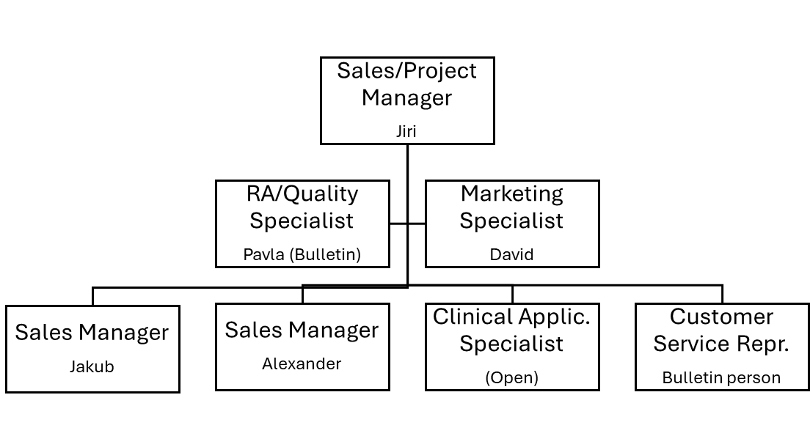
Company presentation – IOL team orgchart
For Quality Specialist function we use external company – Regfem s.r.o.
For Marketing we use expertise of David’s company – Olea Praha s.r.o.

Slide 20
BULLETIN.CZ + HOYA collaboration
Strengthen market position and reputation among MDs, opticians, and optometrists through cooperation between Bulletin and HSO.
Invest in the development of a specialized medical team (especially CAS) to support surgical products and instrumentation.
Allocate resources to local educational initiatives including trainings, webinars, a dedicated education center, international clinic visits, and professional networking for MDs.
We expect training, educational (for MDs) and marketing support from HSO
Leverage bundling opportunities with instrumentation to enhance value for clinics and hospitals.
Bundling with spectacle lenses in combined customers which run optic shops (e.g. Zeiss already works with surgicals and spectacle lenses) and Essilor strong instrumentation background and offer, Optegra purchase)

Slide 21
Distributor- HOYA collaboration
Operational/Marketing Synergies:
experts, KOL network sharing
congresses (e.g. CSRKCH)
bundling deals with spectacle lenses
bundling deals with instrumentation
create market reputation for HOYA IOLs
wide line supplier (complete offer for the O.R.)
covering both countries (CZ+SK where we have sales contacts/customers)
Unmet need - doctors look for instrumentation from lens companies not from instrumentation companies only

Slide 22
Launch Calendar
LAUNCH CALENDAR
Product | Timing | Rationale
Vivinex iSert | Jan/Feb 2026 | Basic line of offered products, used for introduction and training (injector systems, quality, incision size) and for basic offer to price sensitive customers.
Vivinex mSert | Jan/Feb 2026 | Basic line of offered products, used for introduction and training (injector systems, quality, incision size) and for basic offer to quality oriented customers.
Vivinex Toric | Jan/Feb 2026 | Market accepts Toric IOLs very well, the reimbursement and copayments in clinics supports the usage.
Vivinex Impress | Sept 2026 Soft launch | Addition to the monofocal line (Mono+) as advanced product to cover growing market segment. Soft launch with 5-10 selected surgeons for 6 months for getting own experience and data
Vivinex Impress | Mar 2027 Launch | Full Launch to the rest of the market. Surgeon with experience will serve as peer to peer advocates
Vivinex Gemetric family | Mar 2027 Soft Launch | Top line will be soft launched after surgeons’ acceptance of the brand to selected 5-10 quality oriented customers for 6 months. CAS support will be important for surgeons’ support and consultations.
Vivinex Gemetric family | Sep 2027 Launch | Full Launch to the rest of the market. Surgeon with experience will serve as peer to peer advocates

Slide 23
Sales projection 3-years
Please see attached Excel file

Slide 24
Stock management
Initial stock will be purchased – approx. 500 pcs of IOLs for launch phase to have smooth flow, quick deliveries. Small consignment at the customer just with monofocal lenses
The stock will be kept on 4 MOH
Stock increase will be done in line on the starting contracts with hospitals
Customers are used to have consignments on site – we will follow this strategy
Each consignment size sill be determined based on particular agreement with the hospital/implanting surgeon about quantity

Slide 25
Customer targeting
 | public/private approach
Account name/Segment | Public/training hospitals | University hospitals | Private hospitals managed by investors | Private clinic Independent Price focus | Private clinic Independent Quality focus | Private clinic “boutique” clinics | Private clinic Chains with multiple locations
List of Customers | Nemocnice Teplice, prim Cech Nemocnice Pardubice Nemocnice Kolin Nemocnice Most, prim Mach Nemocnice Klatovy, prim Loffelmannova | FN Královské Vinohrady, Praha, prof Studeny, prim Veith Všeobecná fakultní nemocnice, Praha (VFN) Fakultní nemocnice Hradec Králové, doc Hejsek Fakultní nemocnice Plzeň, dr Rusnak Fakultni nemocnice Olomouc, dr Maresova | Nemocnice Vitkovice Ostrava (Agel) prim Juhasova Nemocnice Sumperk (Agel) Nemocnice Sokolov (Penta) | PrahaOfta s.r.o. – Plzeň / Praha OFTEX s.r.o. – Pardubice Oftal Brno – prim Urminsky JL Lestak – Praha | VISUS – Oční centrum Police nad Metují HOS Hradec Kralove | Zlínské oční centrum – MUDr. Smečkova (Zlín) Lensi s.r.o. (Praha) Oční centrum Praha (dr Janekova, prof Pasta) | Lexum Neovize Gemini
Volume: | 1,000 1,000 900 1,000 600 | 4,500 4,000 4,500 3,400 2,000 | 1,200 1,500 1,200 | 3,000 1,500 1 200 900 | 1 500 1 800 | 1,800 4,500 1,000 | 30,000 10,000 20,000
BULLETIN.CZ Priority | 3 | 1 | 4 | 4 | 1 | 1 | 2
Surgeons often have FTEs both at teaching hospitals and private clinics at the same time because there is shortage of experienced surgeons in the market – opportunities to enter private and state through cooperating surgeons.​

Slide 26
KOL advocacy program
 | public/private approach
Account name/Segment | Public/training hospitals | University hospitals | Private hospitals managed by investors | Private clinic Independent Price focus | Private clinic Independent Quality focus | Private clinic “boutique” clinics | Private clinic Chains with multiple locations
KOL further description | Nemocnice Teplice, prim Cech Nemocnice Pardubice, prim Novak Nemocnice Kolin, prim. Rezek Nemocnice Most, prim Mach Nemocnice Klatovy, prim Loffelmannova | FN Královské Vinohrady, Praha, prof Studeny, prim Veith Všeobecná fakultní nemocnice, Praha (VFN) – dr Sklenka, dr Skalicka, dr Diblik Fakultní nemocnice Hradec Králové, doc Hejsek Fakultní nemocnice Plzeň, dr Rusnak Fakultni nemocnice Olomouc, dr Maresova | Nemocnice Vitkovice Ostrava (Agel) prim Juhasova Nemocnice Sumperk (Agel), dr Michalkova Nemocnice Sokolov (Penta), dr Farkas | Ofta s.r.o. – Plzeň / Praha, dr Cendelin OFTEX s.r.o. – Pardubice, dr Korda Oftal Brno – prim Urminsky JL Lestak – Praha, dr Skalicka | VISUS – Oční centrum Police nad Metuj, dr Havlicek, dr Vasa HOS Hradec Kralove, dr Horecky Premium Clinic Teplice, doc Pasta | Zlínské oční centrum – MUDr. Smečkova (Zlín) Lensi s.r.o. (Praha), Mr Abraham Oční centrum Praha (dr Janekova, prof Pasta) | Lexum, Mr Pastucha Neovize, Mr Kocian Gemini. Dr Stodulka
BULLETIN.CZ Priority | 3 | 1 | 4 | 4 | 1 | 1 | 2
First line trial: highlighted yellow

Slide 27

Profile of the key contacts with HOYA
Sales Manager:
Innovative and strategic thinking
English
IOL (premium) work experience
People management
Marketing Manager:
market information
competitive intelligence
English
IOL work experience
Clinical Application:
English
Solid optical background
IOL work experience
Skills to interact with KOL
Attached files:
Position Key Success Factors
Job Description CAS

Slide 28
Team structure – current and future
 | CAS | Area1 (Czechia) | Area2 (Moravia) | Area3 (Slovakia)
Number of Sales Reps/CAS - 2026 | 1 | 1 | 1 (covering Slovakia) | 0
Number of Sales Reps/CAS - 2027 | 1 | 1 | 1 | 1
Number of Sales Reps/CAS - 2028 | 1 | 1 | 1 | 1

Slide 29
Marketing Action Plan - highlights
Visits to clinics in Germany/Austria and France(Impress, Gemetric) for surgeon prospects (Jan-Apr)
CZ reference center creation – trainings, live surgeries (Apr – Jun)
Roundtables/trainings - leading doctors from 3-5 key clinics and hospitals (Feb-May)
Local congresses (2k EUR /event – minimum)
  ČSRKCH – Czech Society of Refractive and Cataract Surgery, www.csrkch.cz, May
  ČOS – Czech Ophthalmological Society, September
5. European congresses (3k EUR / person)
  World Congress of Ophthalmology PRAGUE, June 2026 (if HSO is present)
  Congress of the European Society of Cataract and Refractive Surgeons (ESCRS), September

Slide 30
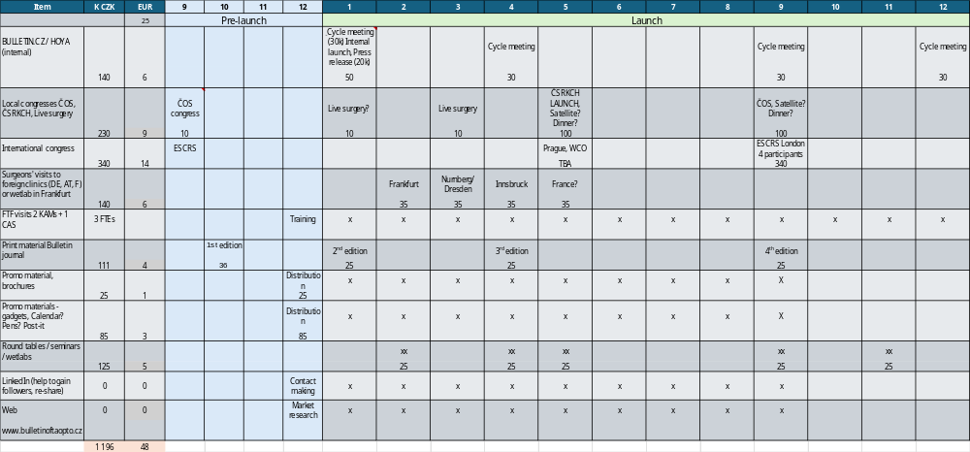
Marketing Action Plan

Slide 31
Registration
Czech Republic
CE Certification
Registration in SÚKL, relatively short and easy because of EU documents
If start in Autumn (Oct/Nov) expectation is to be ready in Q1/2026
Slovak Republic
CE Certification
Registration in ŠÚKL
More complicated because not only Medical device is registered but position in the list of reimbursed IOLs is necessary
If start in Autumn (Nov/Dec) expectation is to be ready in Q3-Q4/2026

